Slide 1
Newton’s Laws

Slide 2
Inertia
is the property of matter that causes it to resist changes in motion.
The inertia of an object depends on the mass of the object.
Inertia is directly proportional to the mass of the object.

Slide 3
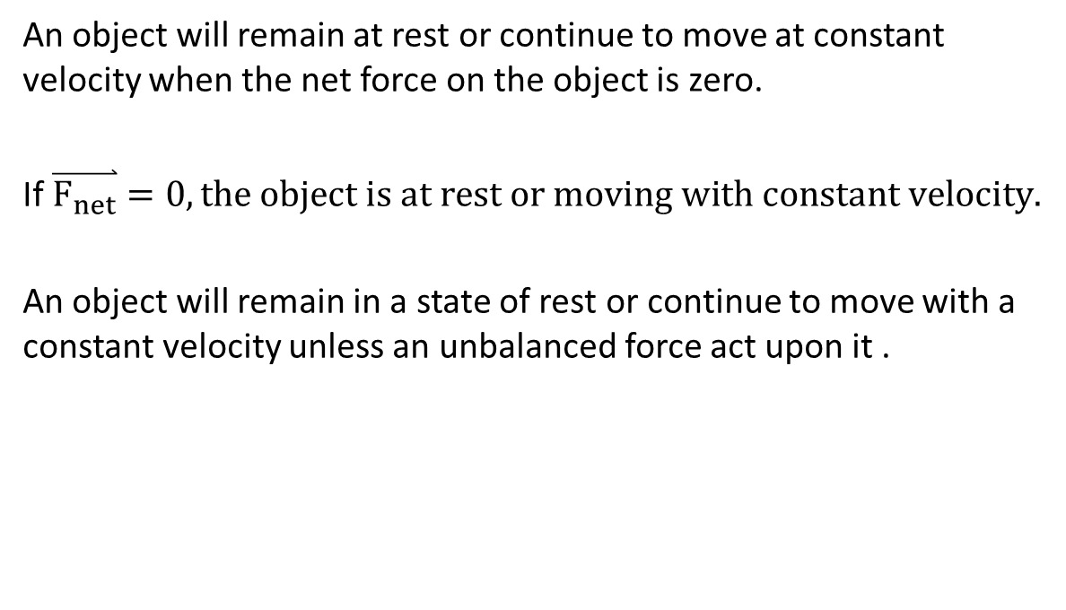
Newton’s First Law of Motion (Inertia Law)
An object will remain at rest or continue to move at constant velocity when the net force on the object is zero.
If $\overset{⃑}{F_{net}}=0, the object is at rest or moving with constant velocity.$
An object will remain in a state of rest or continue to move with a constant velocity unless an unbalanced force act upon it .

Slide 4

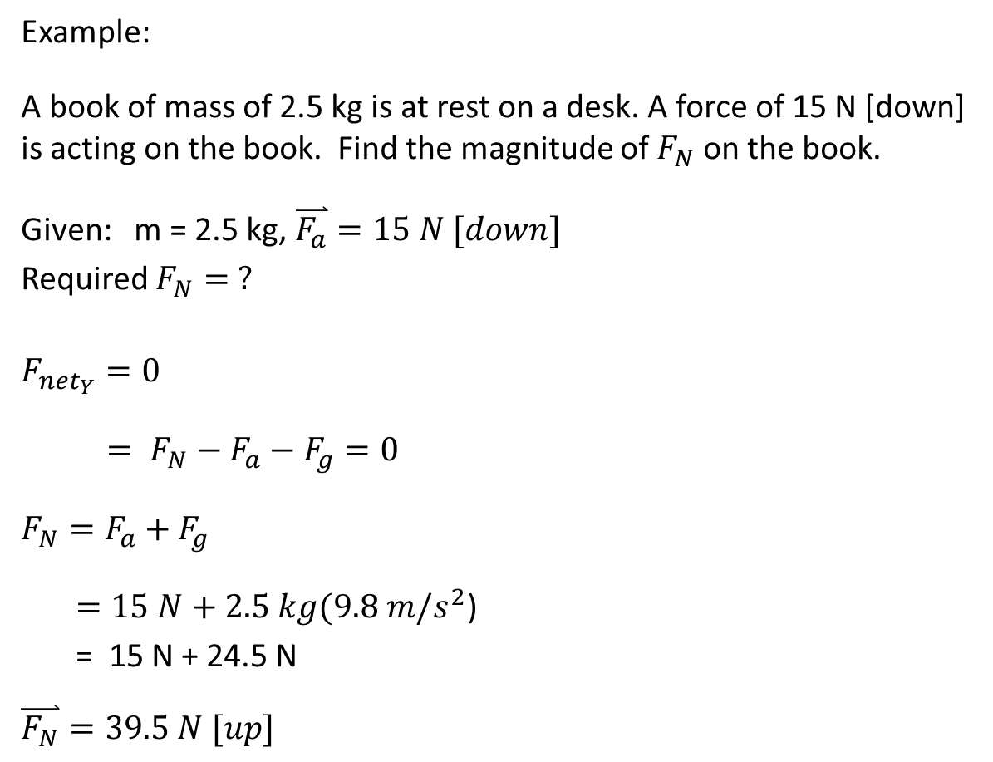


Example:
A book of mass of 2.5 kg is at rest on a desk. A force of 15 N [down] is acting on the book. Find the magnitude of $F_{N}$ on the book.
Given: m = 2.5 kg, $\overset{⃑}{F_{a}}=15 N [down]$
Required $F_{N}= ?$
$$F_{{net}_{Y}}=0$$
$= F_{N}−F_{a}−F_{g}=0$
$F_{N}=F_{a}+F_{g}$
$=15 N+2.5 kg(9.8 m/s^{2}$)
= 15 N + 24.5 N
$$\overset{⃑}{F_{N}}=39.5 N [up]$$
$$F_{N}$$
$F_{a}$=15 N
2.5 kg
$F_{g}$=mg

Slide 5


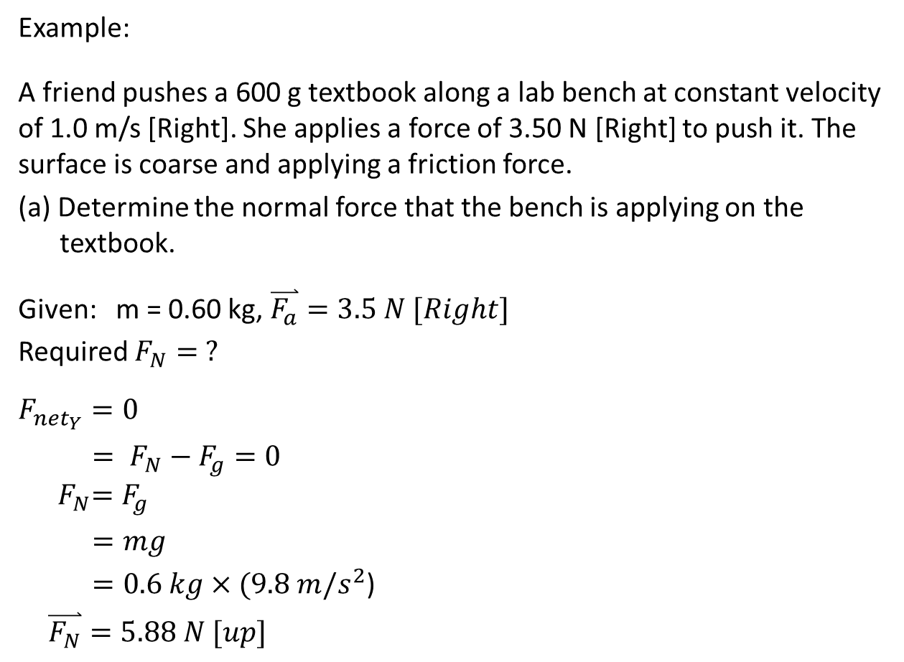



Example:
A friend pushes a 600 g textbook along a lab bench at constant velocity of 1.0 m/s [Right]. She applies a force of 3.50 N [Right] to push it. The surface is coarse and applying a friction force.
(a) Determine the normal force that the bench is applying on the textbook.
Given: m = 0.60 kg, $\overset{⃑}{F_{a}}=3.5 N [Right]$
Required $F_{N}= ?$
$$F_{{net}_{Y}}=0$$
$= F_{N}−F_{g}=0$
$${ F}_{N}=F_{g}$$
$=mg$
$=0.6 kg×(9.8 m/s^{2}$)
$\overset{⃑}{F_{N}}=5.88 N [up]$
$$v=1.0 m/s$$
$$F_{N}$$
$$F_{f}$$
$F_{a}$=3.5 N
0.6 kg
$F_{g}$=mg

Slide 6

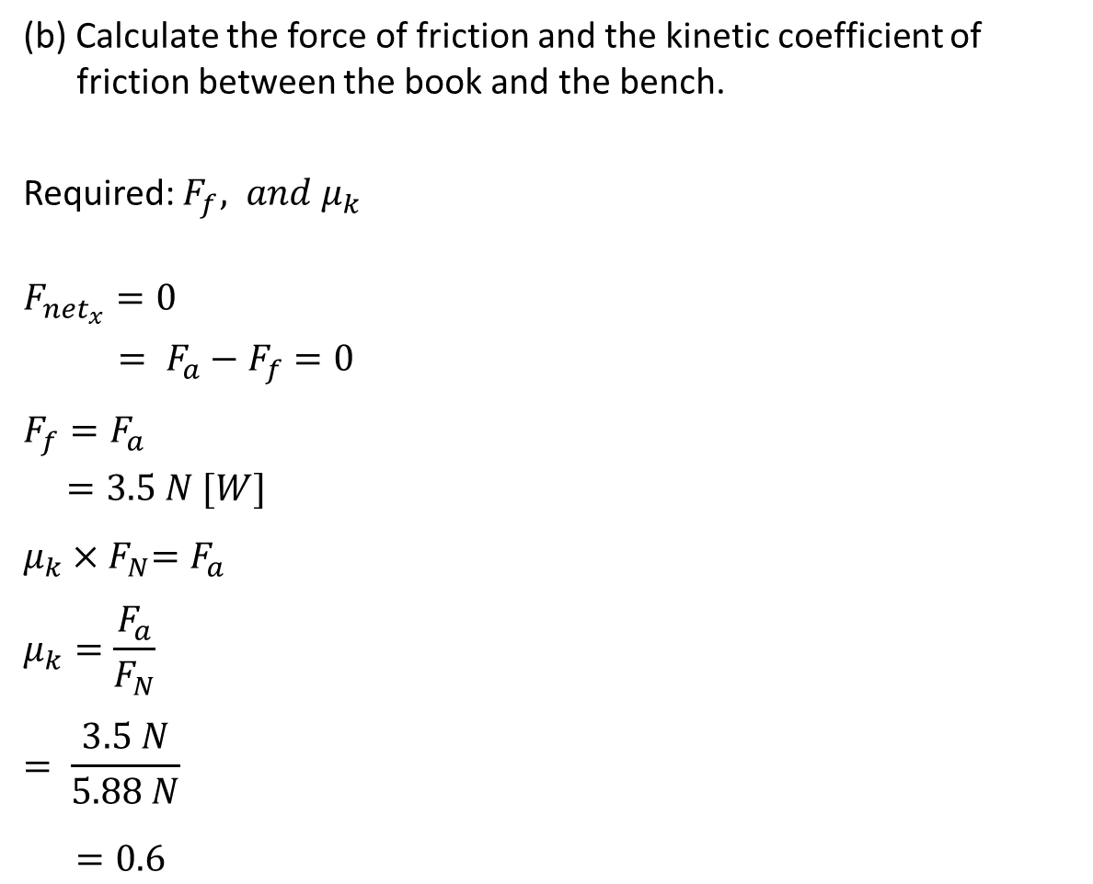



(b) Calculate the force of friction and the kinetic coefficient of friction between the book and the bench.
Required: $F_{f}, and μ_{k}$
$$F_{{net}_{x}}=0$$
$= F_{a}−F_{f}=0$
$$F_{f}=F_{a}$$
$=3.5 N [W]$
$$μ_{k}{×F}_{N}=F_{a}$$
$$μ_{k}=\frac{F_{a}}{F_{N}}$$
$$= \frac{3.5 N}{5.88 N}$$
$=0.6$
$$F_{N}=5.88N$$
$$F_{f}$$
$F_{a}$=3.5 N
0.6 kg
$F_{g}$=mg

Slide 7
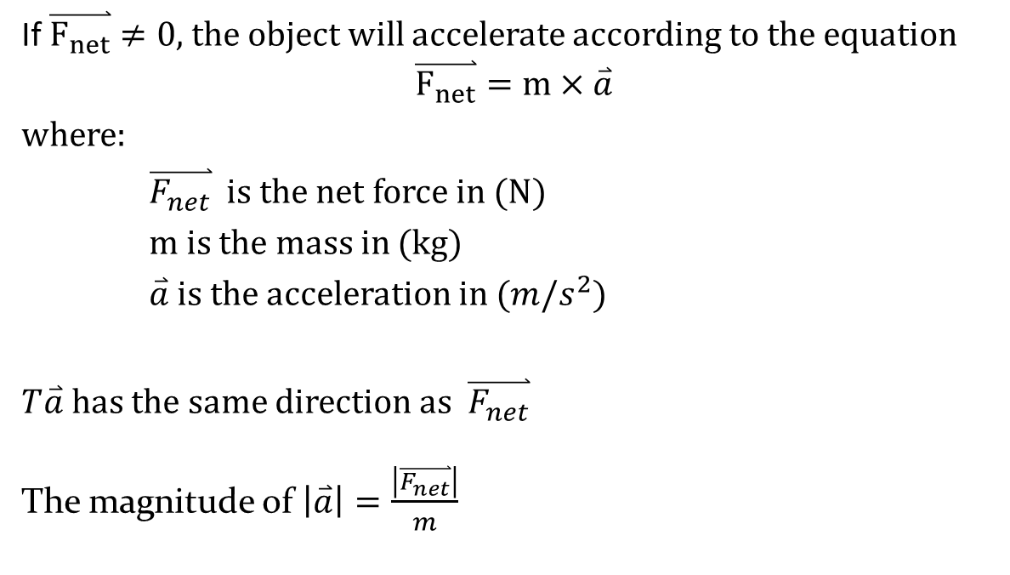
Newton’s Second Law of Motion
If $\overset{⃑}{F_{net}}≠0,$the object will accelerate according to the equation
$$\overset{⃑}{F_{net}}=m×\overset{⃑}{a}$$
where:
$\overset{⃑}{F_{net}}$ is the net force in (N)
m is the mass in (kg)
$\overset{⃑}{a}$ is the acceleration in ($m/s^{2}$)
$T\overset{⃑}{a}$has the same direction as $\overset{⃑}{F_{net}}$
The magnitude of $\left|\overset{⃑}{a}\right|=\frac{\left|\overset{⃑}{F_{net}}\right|}{m}$

Slide 8

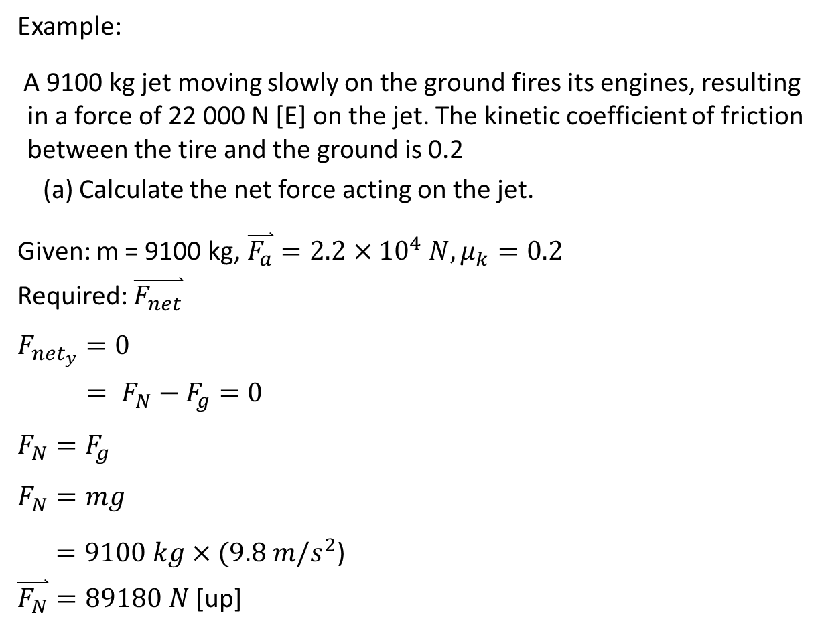



Example:
A 9100 kg jet moving slowly on the ground fires its engines, resulting in a force of 22 000 N [E] on the jet. The kinetic coefficient of friction between the tire and the ground is 0.2
(a) Calculate the net force acting on the jet.
Given: m = 9100 kg, $\overset{⃑}{F_{a}}=2.2×{10}^{4} N, μ_{k}=0.2$
Required: $\overset{⃑}{F_{net}}$
$$F_{{net}_{y}}=0$$
$= F_{N}−F_{g}=0$
$$F_{N}=F_{g}$$
$$F_{N}=mg$$
$=9100 kg×(9.8 m/s^{2}$)
$\overset{⃑}{F_{N}}=89180 N$ [up]
motion
$$F_{N}$$
$$F_{f}$$
$F_{a}$=22000 N
9100 kg
$F_{g}$=mg

Slide 9


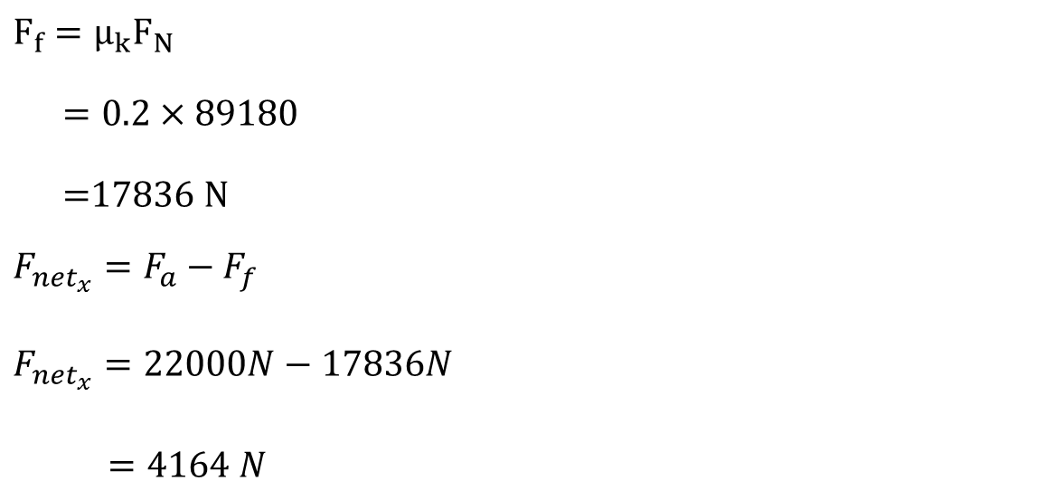



motion
$$F_{f}=μ_{k}F_{N}$$
$=0.2×89180$
$=$17836 N
$$F_{{net}_{x}}=F_{a}−F_{f}$$
$$F_{{net}_{x}}=22000N−17836N$$
$=4164 N$
$F_{N}$=89180$N$
$F_{a}$=22000 N
$F_{f}$=17836 N
$$F_{f}$$
9100 kg
$F_{g}$=89180$N$

Slide 10
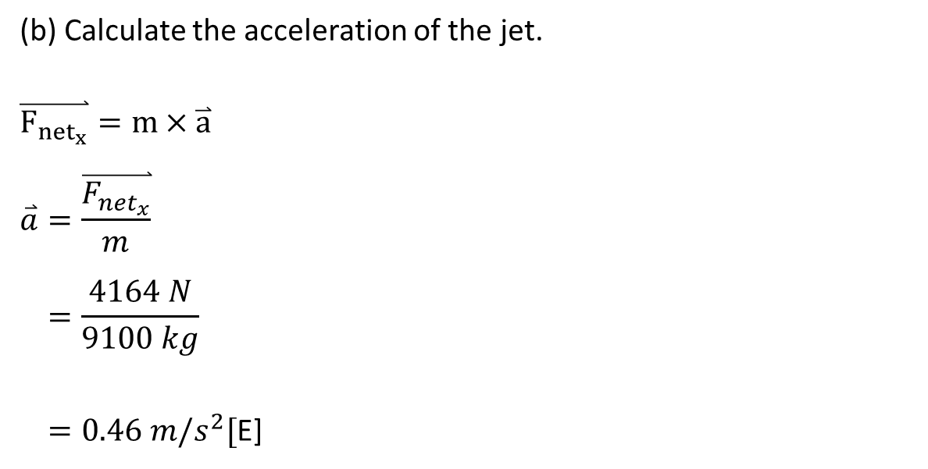

motion
(b) Calculate the acceleration of the jet.
$$\overset{⃑}{F_{{net}_{x}}}=m×\overset{⃑}{a}$$
$$\overset{⃑}{a}=\frac{\overset{⃑}{F_{{net}_{x}}}}{m}$$
$$=\frac{4164 N}{9100 kg}$$
$=0.46 m/s^{2}[$E]
$F_{N}$=89180$N$
$F_{f}$=17836 N
$F_{a}$=22000 N
9100 kg
$F_{g}$=89180$N$

Slide 11
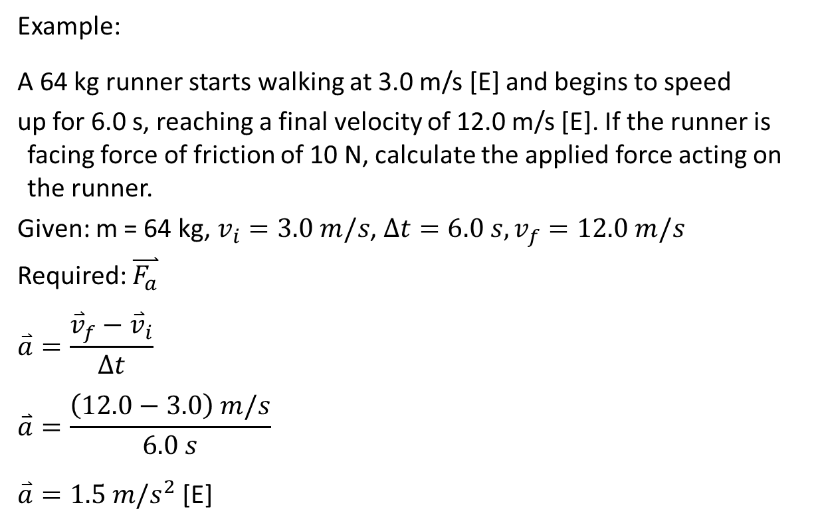
Example:
A 64 kg runner starts walking at 3.0 m/s [E] and begins to speed
up for 6.0 s, reaching a final velocity of 12.0 m/s [E]. If the runner is facing force of friction of 10 N, calculate the applied force acting on the runner.
Given: m = 64 kg, $v_{i}=3.0 m/s$, $∆t=6.0 s, v_{f}=12.0 m/s$
Required: $\overset{⃑}{F_{a}}$
$$\overset{⃑}{a}=\frac{{\overset{⃑}{v}}_{f}−{\overset{⃑}{v}}_{i}}{∆t}$$
$$\overset{⃑}{a}=\frac{\left(12.0−3.0\right) m/s}{6.0 s}$$
$\overset{⃑}{a}=1.5 m/s^{2}$ [E]

Slide 12

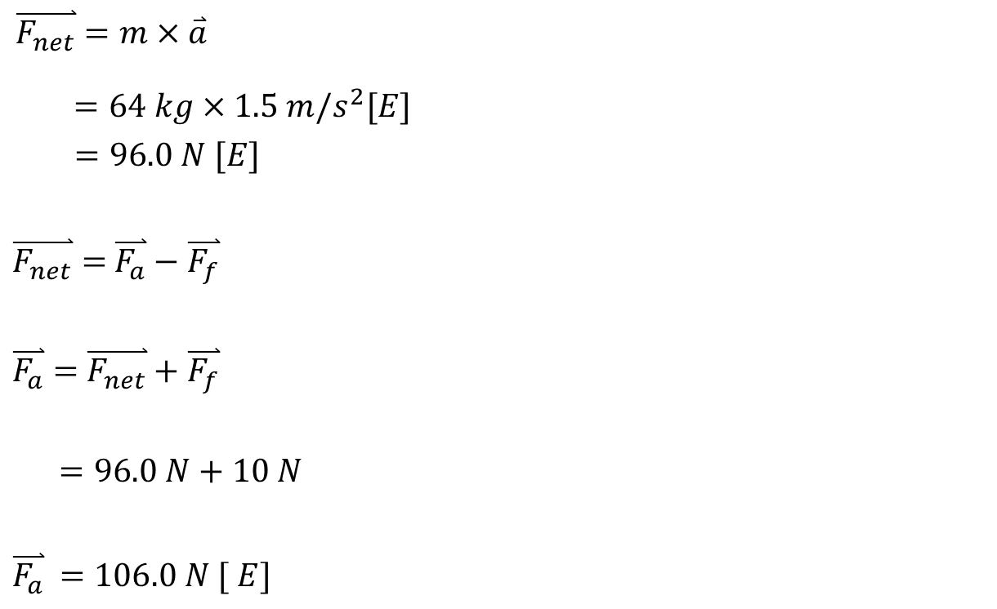



$\overset{⃑}{F_{net}}=m×\overset{⃑}{a}$
$=64 kg×1.5 m/s^{2}[E]$
$=96.0 N [E]$
$\overset{⃑}{F_{net}}=$ $\overset{⃑}{F_{a}}−\overset{⃑}{F_{f}}$
$\overset{⃑}{F_{a}}=$ $\overset{⃑}{F_{net}}+\overset{⃑}{F_{f}}$
$=96.0 N+10 N$
$\overset{⃑}{F_{a}}$ $=106.0 N [ E]$
motion
$$F_{N}$$
$F_{f}$= 10 N
$F_{a}$= ?
64 kg
$$F_{g}$$

Slide 13
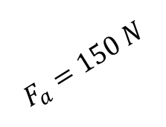
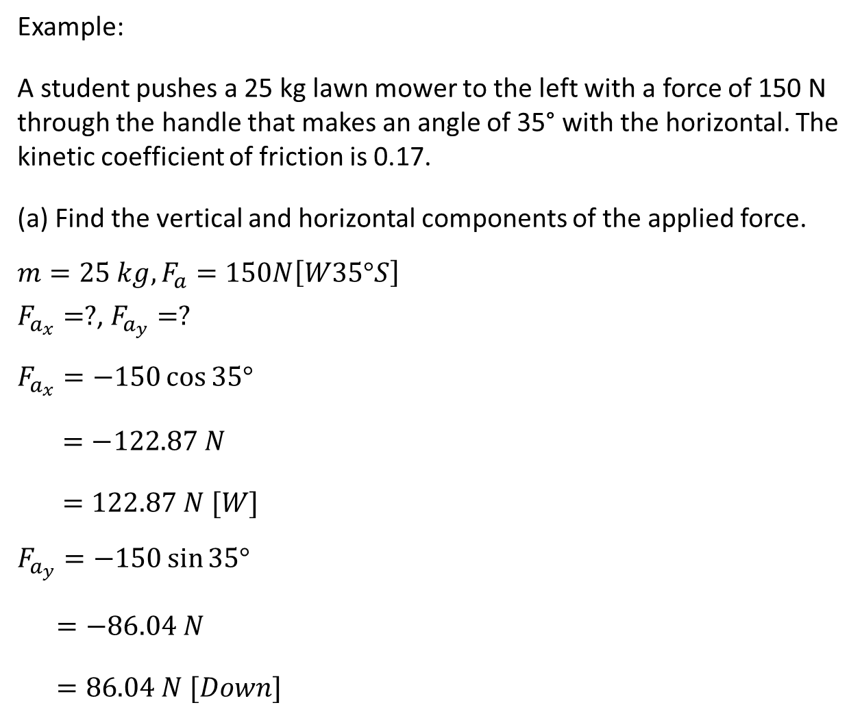



Example:
A student pushes a 25 kg lawn mower to the left with a force of 150 N through the handle that makes an angle of 35° with the horizontal. The kinetic coefficient of friction is 0.17.
(a) Find the vertical and horizontal components of the applied force.
$$m=25 kg, F_{a}=150N\left[W35°S\right]$$
$F_{a_{x}}=?$, $F_{a_{y}}=?$
$$F_{a_{x}}=−150\cos{35°}$$
$=−122.87 N$
$=122.87 N [W]$
$$F_{a_{y}}=−150\sin{35°}$$
$=−86.04 N$
$=86.04 N [Down]$
motion
$$F_{a}=150 N$$
$$F_{a_{y}}$$
25 kg
$$35°$$
$$F_{a_{x}}$$

Slide 14







(b) Calculate the normal force supporting the lawn mower while it is being pushed.
$F_{{net}_{y}}=$ 0
$$= F_{N}−F_{g}−F_{a_{y}}=0$$
$F_{N}=F_{g}+F_{a_{y}}$
$=25kg×(9.8m/s^{2}$)$+ 86.04 N$
$\overset{⃑}{F_{N}}$ $=331.04 N [Up]$
motion
$$F_{N}$$
$$F_{a_{y}}=86.04 N$$
$$F_{a}=150 N$$
$$F_{f}$$
25 kg
$F_{a_{x}}$=122.87 N
$F_{g}$=mg

Slide 15



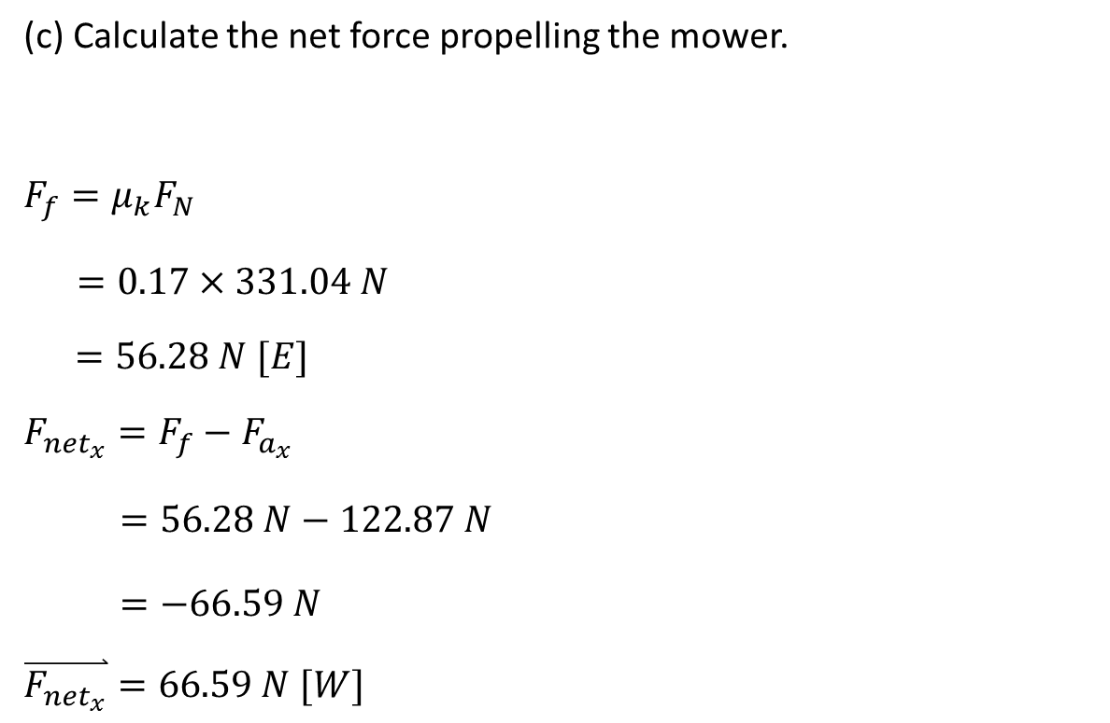

(c) Calculate the net force propelling the mower.
$$F_{f}=μ_{k}F_{N}$$
$=0.17×331.04 N$
$$=56.28 N [E]$$
$$F_{{net}_{x}}=F_{f}−F_{a_{x}}$$
$=56.28 N−122.87 N$
$=−66.59 N$
$$\overset{⃑}{F_{{net}_{x}}}=66.59 N [W]$$
motion
$$F_{a_{y}}=86.04 N$$
$$F_{N}$$
$$F_{f}$$
$$F_{f}=56.28N$$
25 kg
$F_{a_{x}}$=122.87 N
$F_{g}$=mg

Slide 16

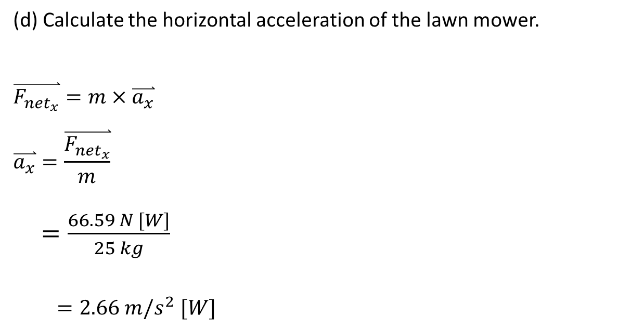

(d) Calculate the horizontal acceleration of the lawn mower.
$$\overset{⃑}{F_{{net}_{x}}}=m×\overset{⃑}{a_{x}}$$
$$\overset{⃑}{a_{x}}=\frac{\overset{⃑}{F_{{net}_{x}}}}{m}$$
$=\frac{66.59 N [W]}{25 kg}$
$=2.66 m/s^{2} [W]$
motion
$$F_{a_{y}}=86.04 N$$
25 kg
$F_{{net}_{x}}$=66.59 N
$F_{g}$=mg
H W questions # 19, 20, 22, 24, 29, 30 35, 36d,I , 38, 39, 43, 48, 50, and 53 on the package pages 144 - 148

Slide 17
Newton’s Third Law

Slide 18
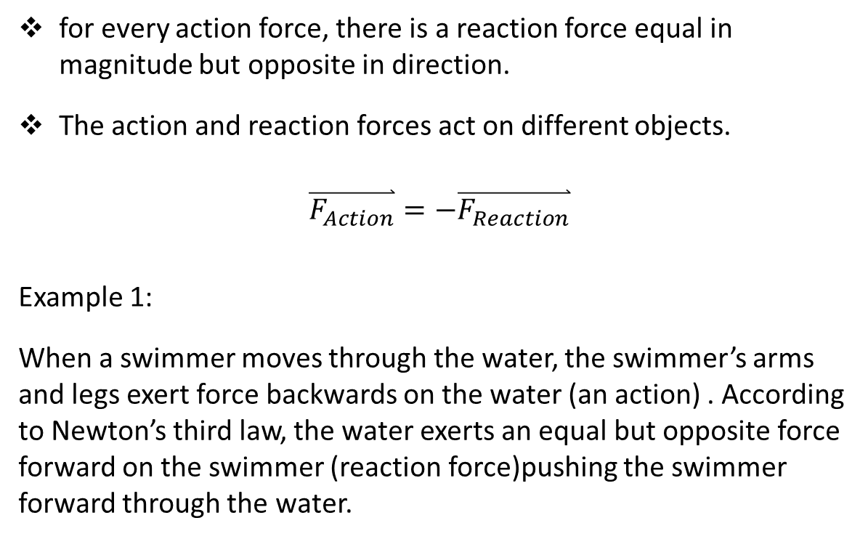
Newton’s Third Law of Motion
for every action force, there is a reaction force equal in magnitude but opposite in direction.
The action and reaction forces act on different objects.
$$\overset{⃑}{F_{Action}}=−\overset{⃑}{F_{Reaction}}$$
Example 1:
When a swimmer moves through the water, the swimmer’s arms and legs exert force backwards on the water (an action) . According to Newton’s third law, the water exerts an equal but opposite force forward on the swimmer (reaction force)pushing the swimmer forward through the water.

Slide 19
Example 2:
When a small balloon releases air and flies around the classroom, the balloon contracts and forces air out back of the balloon (action force). The air pushes back on the balloon(reaction force), which accelerates the balloon forward.
Example 3:
When you start walking across the floor, the bottom of your shoe exerts a horizontal backward force on the floor (action force). The friction force between your shoe and the floor pushes forward on your feet (reaction force).

Slide 20
Example:
Two skaters are standing on ice facing each other. Skater 1 pushes on skater 2 with a force of 70 N[E]. The mass of skater 1 is 50 kg and the mass of skater 2 is 70 kg.
(a) State the action and reaction forces.
F_{1 on 2} = 70 N[E] action force
F_{2 on 1} = 70 N[W] reaction force

Slide 21
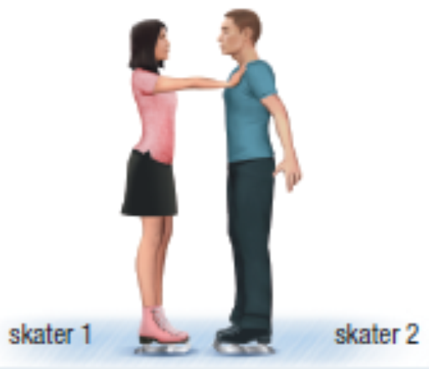








b)If there is friction for their motion, draw the FBD of each skater.
motion
motion
$$F_{N_{1}}$$
$$F_{N_{2}}$$
$$F_{2 on 1}$$
$$F_{f_{1}}$$
$$F_{f_{2}}$$
$$F_{1 on 2}$$
50 kg
70 kg
$$F_{g_{1}}$$
$$F_{g_{2}}$$

Slide 22


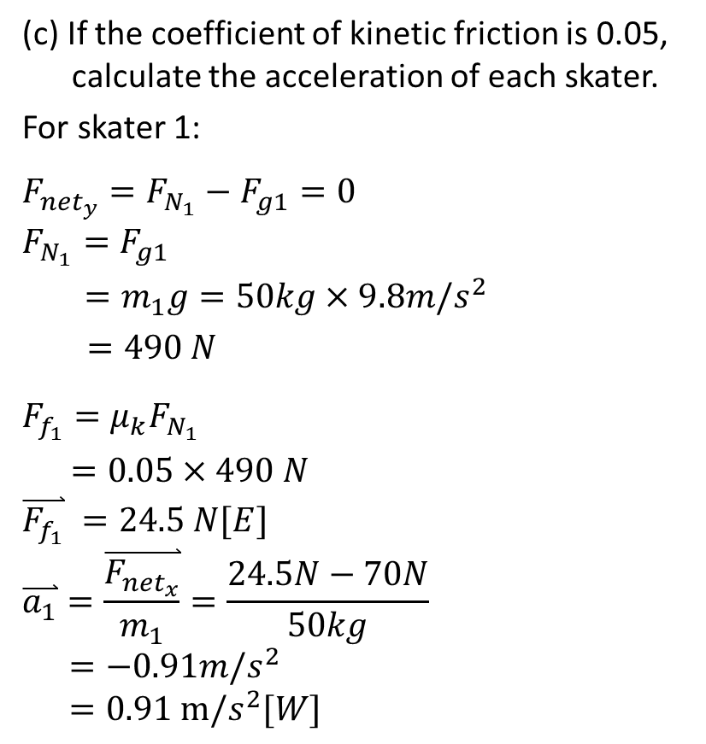



(c) If the coefficient of kinetic friction is 0.05, calculate the acceleration of each skater.
For skater 1:
$$F_{{net}_{y}}={F_{N_{1}}−F}_{g1}=0$$
$${F_{N_{1}}=F}_{g1}$$
$=m_{1}g=50kg×9.8m/s^{2}$
$=490 N$
$$F_{f_{1}}=μ_{k}F_{N_{1}}$$
$=0.05×490 N$
$$\overset{⃑}{F_{f_{1}}} =24.5 N[E]$$
$$\overset{⃑}{a_{1}}=\frac{\overset{⃑}{F_{{net}_{x}}}}{m_{1}}=\frac{24.5N−70N}{50kg}$$
$$=−0.91m/s^{2}$$
$$=0.91 m/s^{2}[W]$$
motion
$$F_{N_{1}}$$
$$F_{f_{1}}=24.5N$$
$$F_{2 on 1}=70N$$
$$F_{f_{1}}$$
50 kg
$$F_{g_{1}}$$

Slide 23



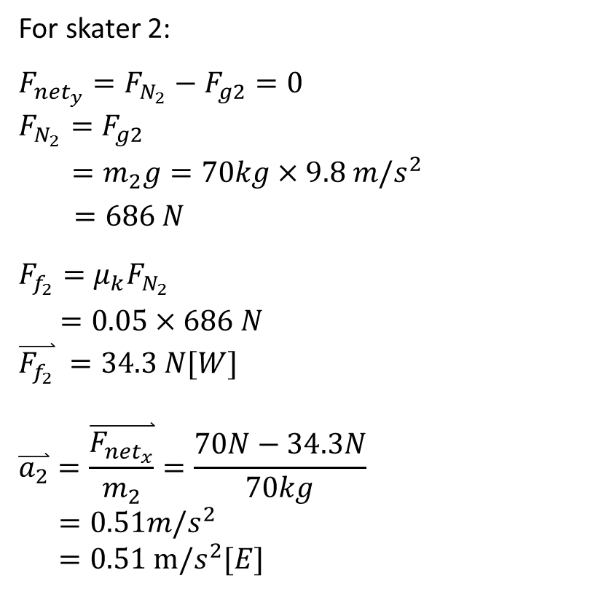


For skater 2:
$$F_{{net}_{y}}={F_{N_{2}}−F}_{g2}=0$$
$${F_{N_{2}}=F}_{g2}$$
$=m_{2}g=70kg×9.8 m/s^{2}$
$=686 N$
$$F_{f_{2}}=μ_{k}F_{N_{2}}$$
$=0.05×686 N$
$$\overset{⃑}{F_{f_{2}}} =34.3 N[W]$$
$$\overset{⃑}{a_{2}}=\frac{\overset{⃑}{F_{{net}_{x}}}}{m_{2}}=\frac{70N−34.3N}{70kg}$$
$$=0.51m/s^{2}$$
$$=0.51 m/s^{2}[E]$$
motion
$$F_{N_{2}}$$
$$F_{f_{2}}=34.3N$$
$$F_{f_{2}}$$
$F_{1 on 2}$=70N
70 kg
$$F_{g_{2}}$$

Slide 24
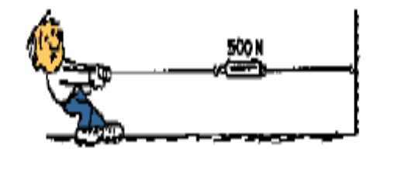




Tension Force
Example:
Two people pull on opposite ends of the rope, each with a force of 50 N. Draw a FBD for the forces acting on the rope.
When each person pulls with a force
of 50 N, the rope experiences a tension force of 50 N. This would be similar to a person tying the rope to a wall and pulling the force would still be the same)
50 N
$$F_{T}=50N$$
$$F_{T}=50N$$
$$F_{a}=50N$$
$$F_{a}=50N$$
50 N
H W questions # 1 – 9 on the page 141 of the textbook.

